Slide 1

Web Application Testing EMP
final project

Slide 2



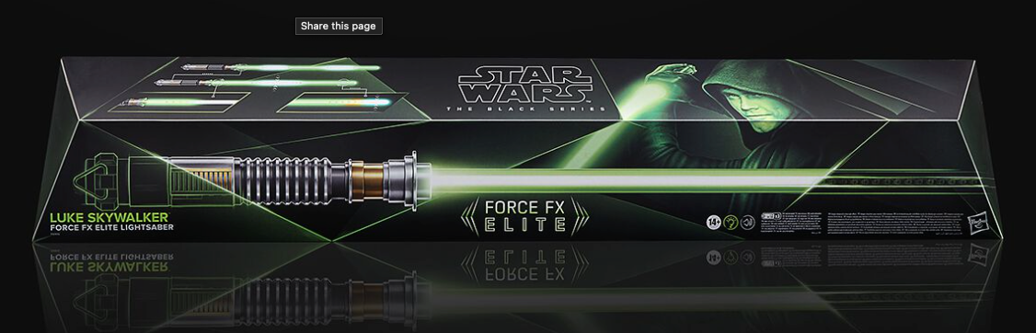
APPLICATION DESCRIPTION
EMP
Web application
Merchant, music, movie, tv & gaming merch
Alternative clothing
International shipping

Slide 3
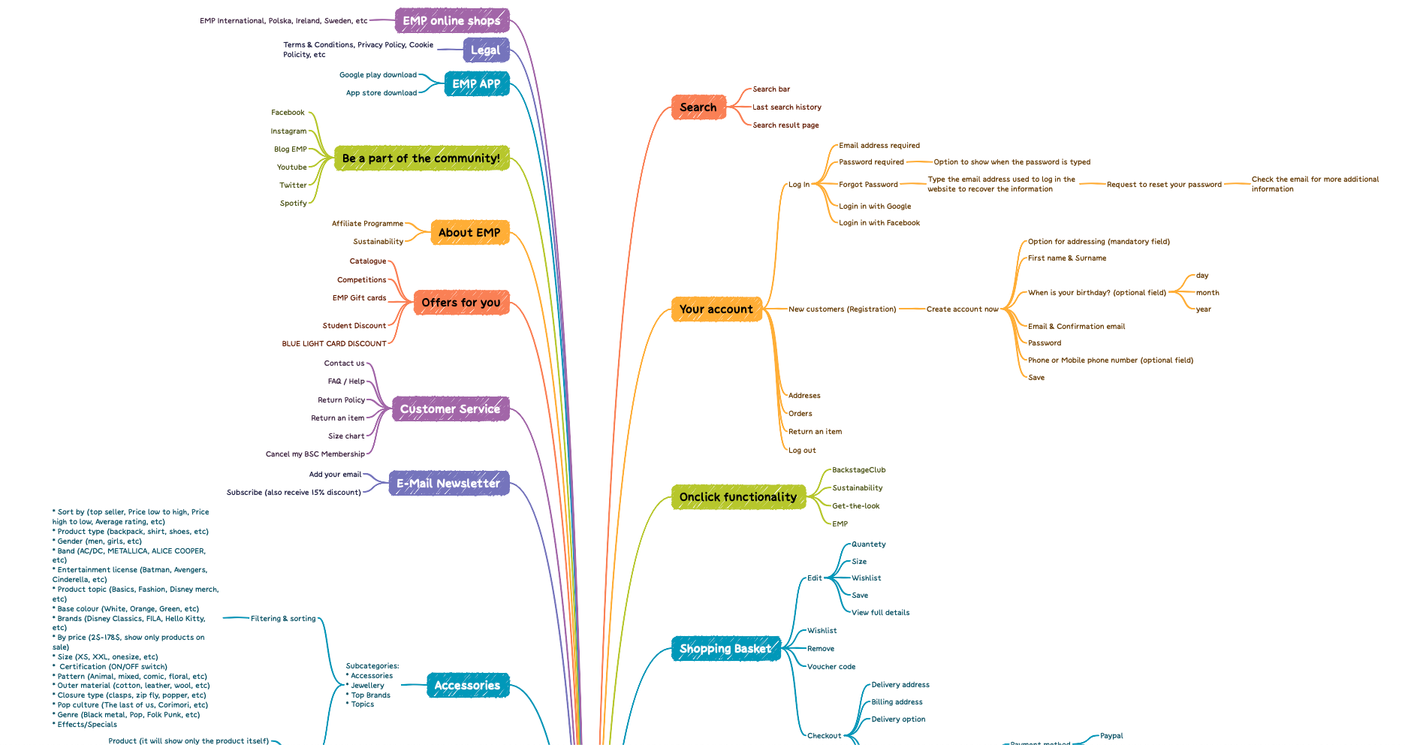
EMP website MIND MAP

Slide 4
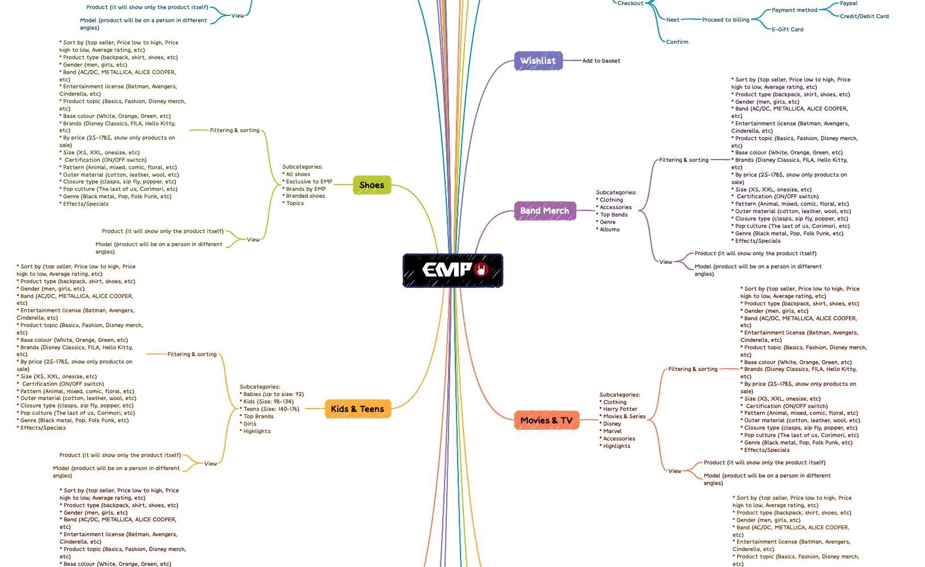

Slide 5
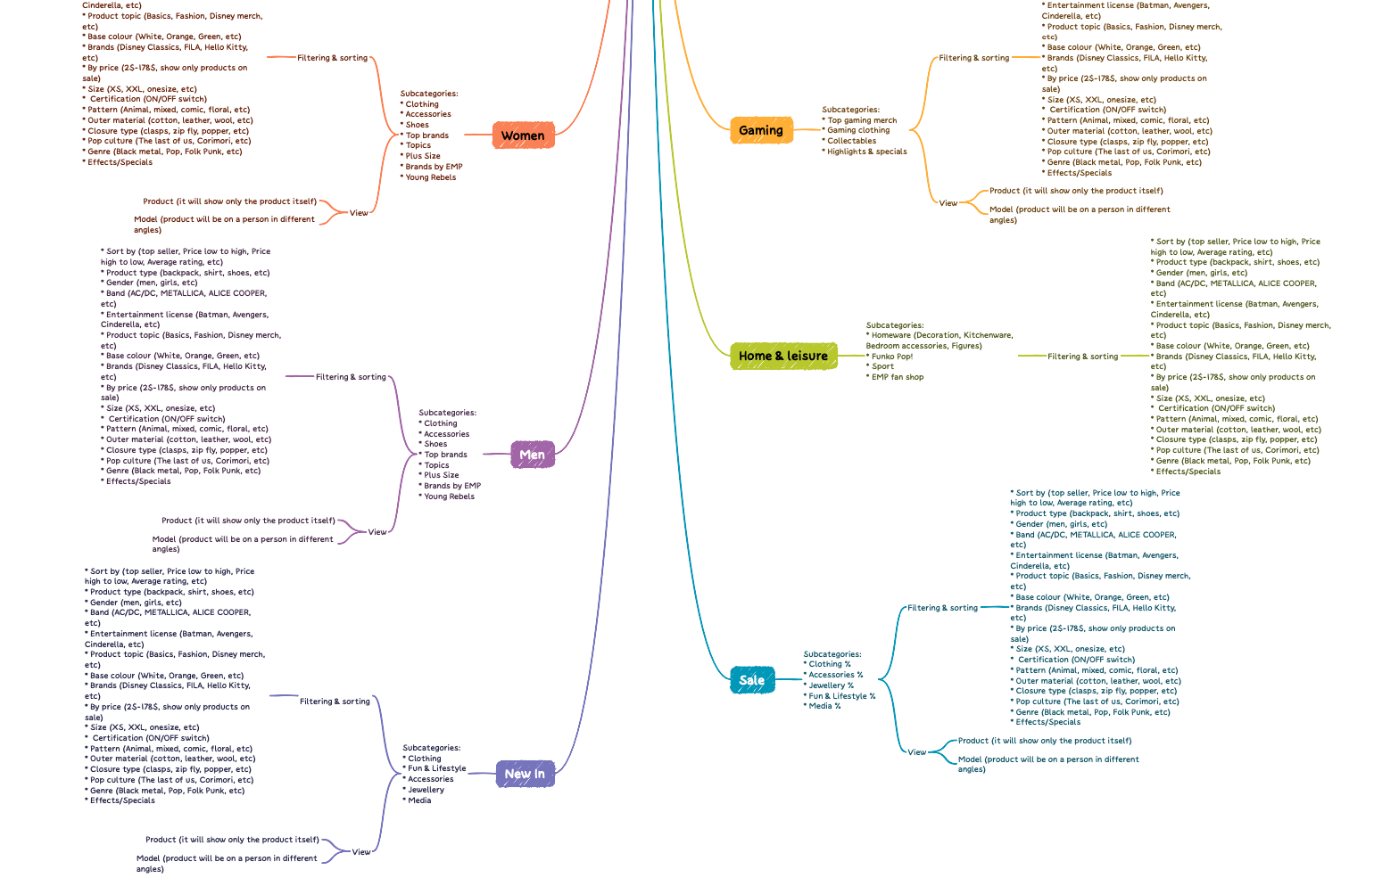

Slide 6

TESTING APPROACH FOR EMP
Positive testing to show that a product or application under test does what it is supposed to do
Exploratory Testing for main functionalities and site overview
Document the Exploratory Testing and write down the defects so they can be replicated
Component Testing, Integration, System, Performance Testing
Focus where bugs were identified, more testing for that area
Write the Smoke tests and execute them
Write the Test Report

Slide 7

Mantis Bug Tracker – Bug Reporting
Shottr – Screenshots Capture
Mailinator – Test Emails
Xmind Tool – Mind Maps
Excel/word/power point – Presentation layers
Generatedata.com –generate random data

Slide 8



TESTING TYPES
Functional Testing
Exploratory Testing
Negative Testing
Positive Testing
Smoke Testing
Compatibility Testing
UI Testing
Usability Testing
Performance Testing
Security Testing
Performance Testing
Security Testing
Recovery Testing

Slide 9
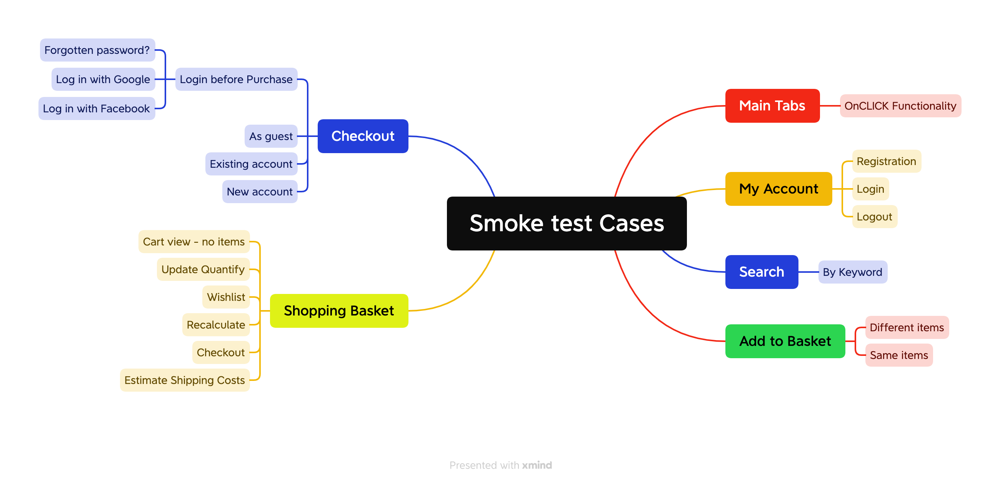
Total: 23 Test Cases

Slide 10
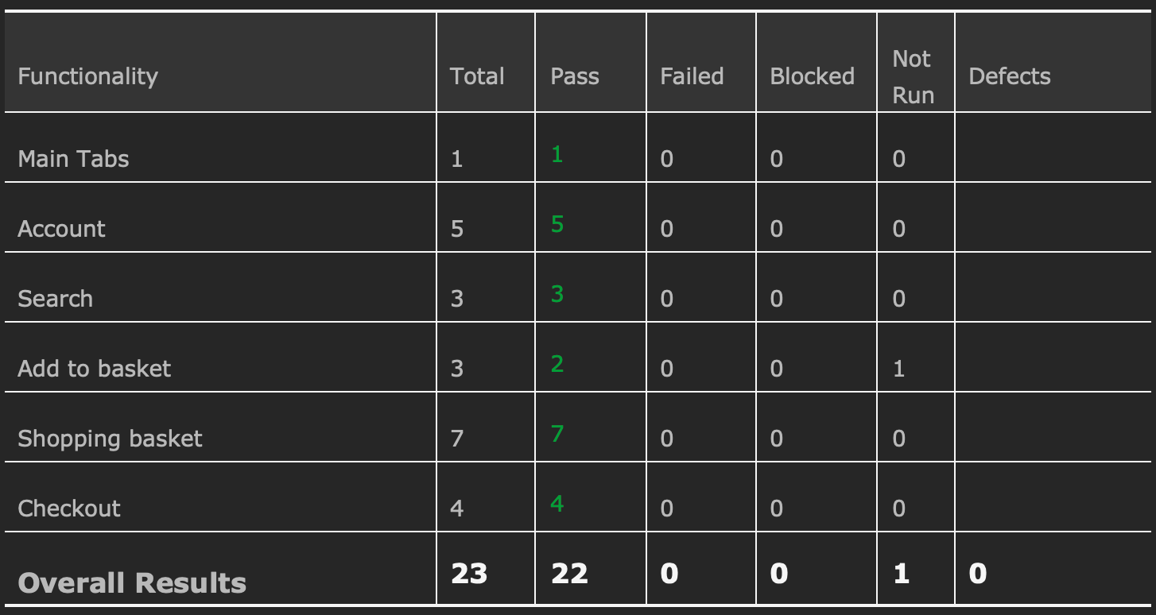
TEST CASE RESULTS FOR SMOKE TEST

Slide 12

CONCLUSIONS
23 Test Cases were executed to test the happy flows: 22 passed and 1 not tested
7 bugs identified: 1 major, 1 critical and 5 normal
All of the bugs were identified by performing Exploratory Testing
Data type used during testing: Blank, Valid, Invalid, Big Data
Fixing at least the major and critical severity bugs is recommended

Slide 13


LESSONS LEARNED
difficulty in finding bugs, as the site is an established and popular one
Lack of requirements
The user does not have the option to manually add as many products as he/she wants (e.g. in the shopping basket we add 120 products); i was not able to test the invalid data for that specific functionality
Keep the bug reporting and test cases steps and results easy to follow
Exploratory Testing facilitates learning of functionalities
The browser or application attempted to connect to a resource on a server that could not be found, error 404
Being a large site, it would be best to divide it into different parts and functionalities. This can help us process less information, step by step, and write more objective test cases while simplifying the process.

Slide 14


